Slide 1
Speech synthesis

Slide 2
Speech synthesis
What is the task?
  Generating natural sounding speech on the fly, usually from text
What are the main difficulties?
  What to say and how to say it
How is it approached?
  Two main approaches, both with pros and cons
How good is it?
  Excellent, almost unnoticeable at its best
How much better could it be?
  marginally

Slide 3
Input type
Concept-to-speech vs text-to-speech
In CTS, content of message is determined from internal representation, not by reading out text
  E.g. database query system
  No problem of text interpretation

Slide 4
Text-to-speech
What to say: text-to-phoneme conversion is not straightforward
  Dr Smith lives on Marine Dr in Chicago IL. He got his PhD from MIT. He earns $70,000 p.a.
  Have toy read that book? No I’m still reading it. I live in Reading.
How to say it: not just choice of phonemes, but allophones, coarticulation effects, as well as prosodic features (pitch, loudness, length)

Slide 5
Architecture of TTS systems
Text-to-phoneme module
Phoneme-to-speech module
Text input
Synthetic speech output
Normalization
Abbreviation lexicon
Text in orthographic form
Acoustic synthesis
Various methods
Exceptions lexicon
Grapheme-to-phoneme conversion
Orthographic rules
Phoneme string + prosodic annotation
Grammar rules
Phoneme string
Prosodic modelling
Prosodic model

Slide 6
Text normalization
Any text that has a special pronunciation should be stored in a lexicon
  Abbreviations (Mr, Dr, Rd, St, Middx)
  Acronyms (UN but UNESCO)
  Special symbols (&, %)
  Particular conventions (£5, $5 million, 12°C)
  Numbers are especially difficult
    1995 2001 1,995 236 3017 233 4488

Slide 7
Grapheme-to-phoneme conversion
English spelling is complex but largely regular, other languages more (or less) so
Gross exceptions must be in lexicon
Lexicon or rules?
  If look-up is quick, may as well store them
  But you need rules anyway for unknown words
MANY words have multiple pronunciations
  Free variation (eg controversy, either)
  Conditioned variation (eg record, import, weak forms)
  Genuine homographs

Slide 8
Grapheme-to-phoneme conversion
Much easier for some languages (Spanish, Italian, Welsh, Czech, Korean)
Much harder for others (English, French)
Especially if writing system is only partially alphabetic (Arabic, Urdu)
Or not alphabetic at all (Chinese, Japanese)

Slide 9
Syntactic (etc.) analysis
Homograph disambiguation requires syntactic analysis
  He makes a record of everything they record.
  I read a lot. What have you read recently?
Analysis also essential to determine appropriate prosodic features

Slide 10
Architecture of TTS systems
Text-to-phoneme module
Phoneme-to-speech module
Text input
Synthetic speech output
Normalization
Abbreviation lexicon
Text in orthographic form
Acoustic synthesis
Various methods
Exceptions lexicon
Grapheme-to-phoneme conversion
Orthographic rules
Phoneme string + prosodic annotation
Grammar rules
Phoneme string
Prosodic modelling
Prosodic model

Slide 11
Prosody modelling
Pitch, length, loudness
Intonation (pitch)
  essential to avoid monotonous robot-like voice
  linked to basic syntax (eg statement vs question), but also to thematization (stress)
  Pitch range is a sensitive issue
Rhythm (length)
  Has to do with pace (natural tendency to slow down at end of utterance)
  Also need to pause at appropriate place
  Linked (with pitch and loudness) to stress

Slide 12
Acoustic synthesis
Alternative methods:
  Articulatory synthesis
  Formant synthesis
  Concatenative synthesis
  Unit selection synthesis

Slide 13
Articulatory synthesis
Simulation of physical processes of human articulation
Wolfgang von Kempelen (1734-1804) and others used bellows, reeds and tubes to construct mechanical speaking machines
Modern versions simulate electronically the effect of articulator positions, vocal tract shape, etc.
Too much like hard work

Slide 14
Formant synthesis
Reproduce the relevant characteristics of the acoustic signal
In particular, amplitude and frequency of formants
But also other resonances and noise, eg for nasals, laterals, fricatives etc.
Values of acoustic parameters are derived by rule from phonetic transcription
Result is intelligible, but too “pure” and sounds synthetic

Slide 15

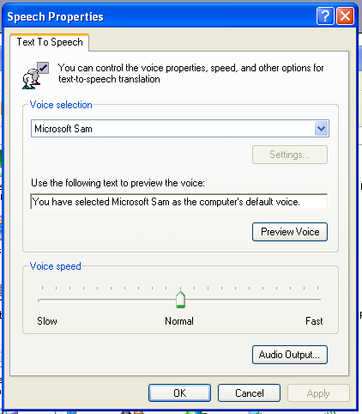
Formant synthesis
Demo:
  In control panel select “Speech” icon
  Type in your text and Preview voice
  You may have a choice of voices

Slide 16
Concatenative synthesis
Concatenate segments of pre-recorded natural human speech
Requires database of previously recorded human speech covering all the possible segments to be synthesised
Segment might be phoneme, syllable, word, phrase, or any combination
Or, something else more clever ...

Slide 17
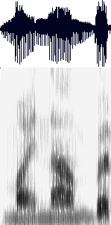
Diphone synthesis
Most important for natural sounding speech is to get the transitions right (allophonic variation, coarticulation effects)
These are found at the boundary between phoneme segments
“diphones” are fragments of speech signal cutting across phoneme boundaries
If a language has P phones, then number of diphones is ~P² (some combinations impossible) – eg 800 for Spanish, 1200 for French, 2500 for German)
m y n u m b er

Slide 18
Diphone synthesis
Most systems use diphones because they are
  Manageable in number
  Can be automatically extracted from recordings of human speech
  Capture most inter-allophonic variants
But they do not capture all coarticulatory effects, so some systems include triphones, as well as fixed phrases and other larger units (= USS)

Slide 19
Concatenative synthesis
Input is phonemic representation + prosodic features
Diphone segments can be digitally manipulated for length, pitch and loudness
Segment boundaries need to be smoothed to avoid distortion

Slide 20
Unit selection synthesis (USS)
Same idea as concatenative synthesis, but database contains bigger variety of “units”
Multiple examples of phonemes (under different prosodic conditions) are recorded
Selection of appropriate unit therefore becomes more complex, as there are in the database competing candidates for selection

Slide 21
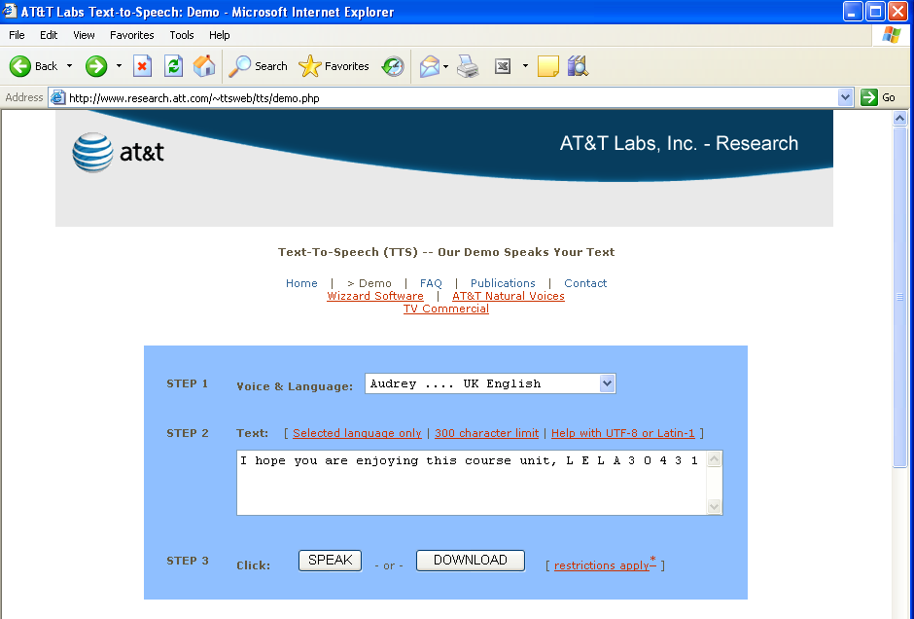
Speech synthesis demo

Slide 22
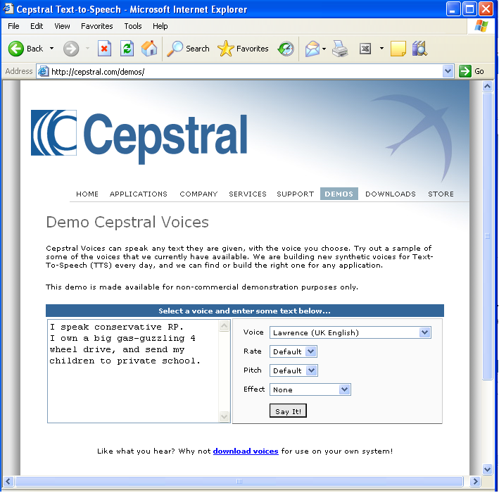
Speech synthesis demo

